Slide 1
The Vikings

Slide 2
Tonight I fear not the Vikings
‘Bitter is the wind tonight
It tosses the ocean’s white hair
Tonight I fear not the fierce warriors of Norway
Coursing on the Irish sea‘
(A translation by Kuno Meyer)

Slide 3
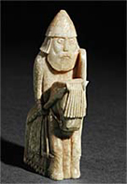
793-late 11th century-The Viking Age

Slide 4
Longships

Slide 5
Longships

Slide 6
Longships
Later ones have iron clad edges
Crews could range up to 100 people
Horses and provision on board
Fleet would be made up of about 100 ships
Tie ships together when battles at sea and goal was to capture the opponent’s ships and resources

Slide 7
Viking Battle on Sea

Slide 8
Viking Military
No professional, standing army
Weapons training began with hunting, sports and raiding
Fame came with war and victory
Which means?

Slide 9
Boar Formation

Slide 10
Shield Wall

Slide 11
Berserks
work themselves into a battle frenzy so intense it is said ...they could even ignore the pain of wounds.

Slide 12
Children
Adult by 10 years old
Boys worked the farm, girls work the house
Some learned how to read and write – Rune letters and Norse language
Fighting was essential
Some strong girls would be trained as soldiers
Valkyries – female soldiers on horseback that would decide who dies on the battlefield – prey
Sick and weak children would be left in the wilderness or thrown at sea

Slide 13
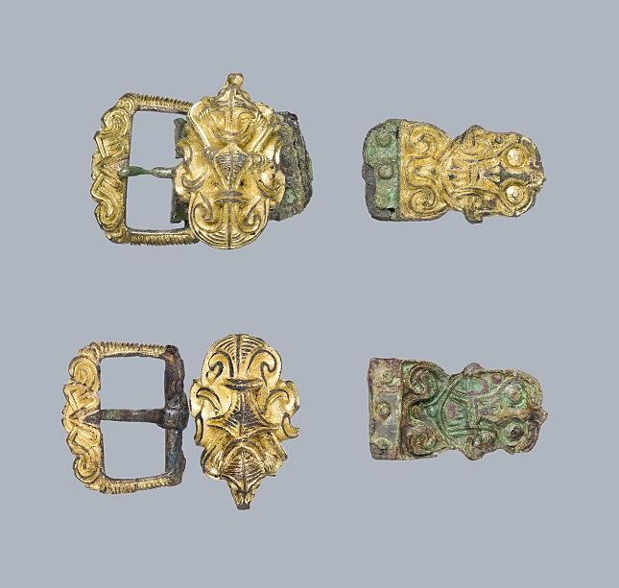
Viking Clothing

Slide 14
Viking Women
Rough treatment
Polygamy
Property of men
Limited rights(but more than Europeans)
Some evidence of political power
Some evidence of soldiers

Slide 15
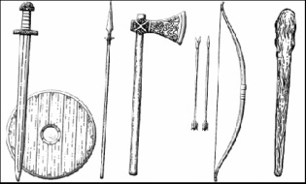
Viking Weapons
Axe was the most popular weapon and tool. Made of iron and religious symbols.
Noted to be able to shoot an arrow 200 meters. 656 feet
Swords about 90 cm long. About 3 feet long. Made of gold and silver. Named and buried with soldier.
Helmets often would show wealth. Very few with horns. About 9 lbs.
Longships
Greek Fire

Slide 16
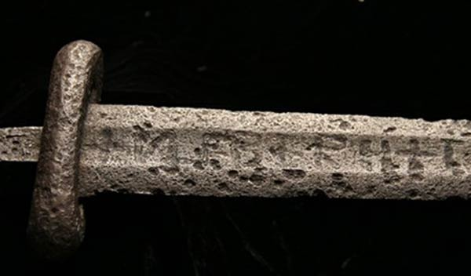

Slide 18
Pop Quiz
What Anglo Saxon King converted the Danes to Christianity?
What was the name of the portion of England where the Vikings lived and governed themselves?
3. What was the name of the legends of the Norse gods describing their exploits and fights? (And helps us understand their values and belief systems)
4. What architectural design was made popular in Kiev, Russia under Yaroslav the Wise (now the Ukraine)?

Slide 19
Alfred the Great
“For in prosperity a man is often puffed up with pride, whereas tribulations chasten and humble him through suffering and sorrow. In the midst of prosperity the mind is elated, and in prosperity a man forgets himself; in hardship he is forced to reflect on himself, even though he be unwilling. In prosperity a man often destroys the good he has done; amidst difficulties he often repairs what he long since did in the way of wickedness.” ― King Alfred
What medieval philosopher does this mirror?

Slide 20
Alfred the Great
“The saddest thing about any man is that he be ignorant, and the most exciting thing is that he knows.” ― Alfred the Great
“Very often it has come to my mind what men of learning there were formerly throughout England...and how nowadays...we would have to seek them outside...Thanks be to God Almighty that we now have any supply of teachers at all!...As often as you can, free yourself from worldly affairs so that you may apply that wisdom which God gave you wherever you can. Remember what punishments befell us in this world when we ourselves didn't cherish learning nor transmit it to other men.”
What is the impact on literacy during Alfred’s reign?

Slide 21
Yaroslav the Wise

Slide 22
Yaroslav the Wise
Son of Vladimir - he converts to Christianity due to his future wife demanding it in exchange for Byzantine military support to intervene in wars in Constantinople
Yaroslav will see Kiev to its height – (r. 1015-1054). Modern day Ukraine.
Will create independence in Kiev from Constantinople
Books from Greek to Slavic
Cathedral at Kiev was a masterpiece
Onion domes
Churches, markets vs. 20,000 people
Schools and educated women
Agriculture is #1and trade allowed large cities
Yaroslav dies and land divided amongst the male heirs

