Slide 1
Romanesque Art
Concepts and Art

Slide 2
Period 1 Pop Quiz
Separate sheet of paper with your name
1. What country developed Gothic style architecture?
2. Who built the first example of a Gothic style church?
3. What kind of arches were developed in Gothic style?

Slide 3
Bell work 2-14-20
Why was art and sculpture used to influence medieval society?

Slide 4
Why did Romanesque Architecture flourish?
More members of the church
Crusades, increase in faith
Primitive construction techniques
New-found appreciation of education, illuminations, manuscripts
Need for churches

Slide 5
Three Part System of Society
Teaching
Defending
Nurturing
What feudal roles do these represent in medieval society?

Slide 6
Medieval Trinity
Clergymen
Knights
Farmers
What does each role do?
How do these roles work together?

Slide 7
Three Social Classes
The belief that these roles are pre-determined by God.
How does this impact the individual fulfilling their role in society?

Slide 8
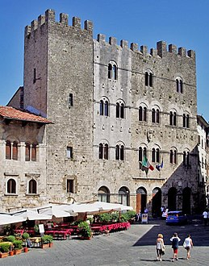

Slide 9
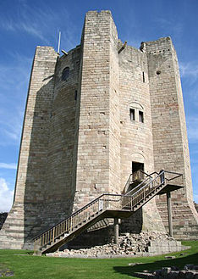

Slide 10
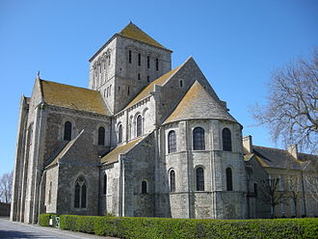

Slide 11
How would the medieval viewer interpret the image to the left?
What is the artist attempting to say? Is it effective?

Slide 12
Discussion Question
How can fear influence an individual?

Slide 13
Unexpected Death
What is the fear of an unexpected death?

Slide 14
Unable to repent
Unable to pray
Can mean to the medieval mind = purgatory, hell, eternal damnation

Slide 15
Examples of Romanesque Art Anti-realism

Slide 21
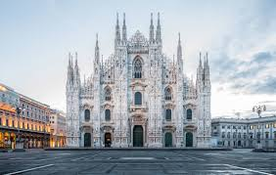
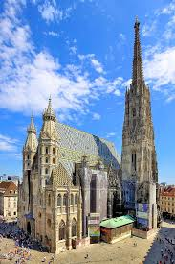
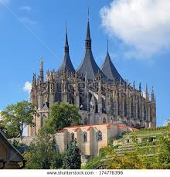
When we come back…

