Slide 1
Romanesque Architecture

Slide 2
Bell Work – 2-26-19
What was the message behind Romanesque Architecture?

Slide 3
Romanesque Architecture Dates
~1000-1200, though some date as early as 800

Slide 4
Romanesque
Roman style
Roman, rounded arches
Wood roof; 1000 stone roofs (heavy)
Thick stone walls and small windows
2-3 stories high (generally)
Stone exterior decoration
Anti-realism – the world see by faith
Reform, judgement
Gregorian chant

Slide 8
Calotte

Slide 9
Cell

Slide 10
Chancel

Slide 11
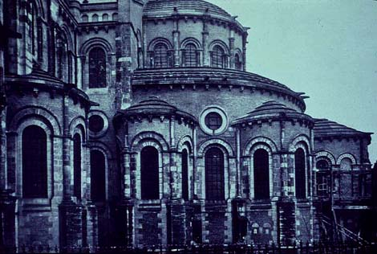
Chevet

Slide 12
Transept

Slide 13
Nave

Slide 14
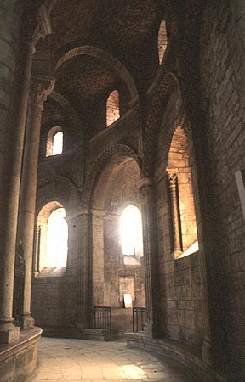
Ambulatory

Slide 15
Lighting
Problems with this?
Candles?
Original ceilings were wood and flat

Slide 16
Solution
Stone ceilings
More complex floor plans
Need for height
How to make structurally sound?

Slide 17
Barrel Vault

Slide 18
Groin Vault

Slide 19
Cross Section
Nave
Aisle
Aisle

Slide 20
Crossing

Slide 21
Lancet Window

Slide 22
Oculus

Slide 23
Floor Plan - Latin Cross

