Slide 1
Gothic Art and architecture

Slide 2
Bell work 2-19-20 Romanesque and Gothic
What led to the transition from Romanesque to Gothic?

Slide 3
Monastic thought
Monasteries in Europe emphasized a simplistic life.
As those Romanesque cathedrals became worn-down and sometimes ruined/destroyed, a new frame of thought developed: Light.
Transform the viewer from “material” to “immaterial.”
Define material
Define immaterial

Slide 4
Abbot Suger
All you who seek to honor these doors, Marvel not at the gold and expense but at the craftsmanship of the work. The noble work is bright, but, being nobly bright, the work Should brighten the minds, allowing them to travel through the lights. To the true light, where Christ is the true door. The golden door defines how it is imminent in these things. The dull mind rises to the truth through material things, And is resurrected from its former submersion when the light is seen.’

Slide 5
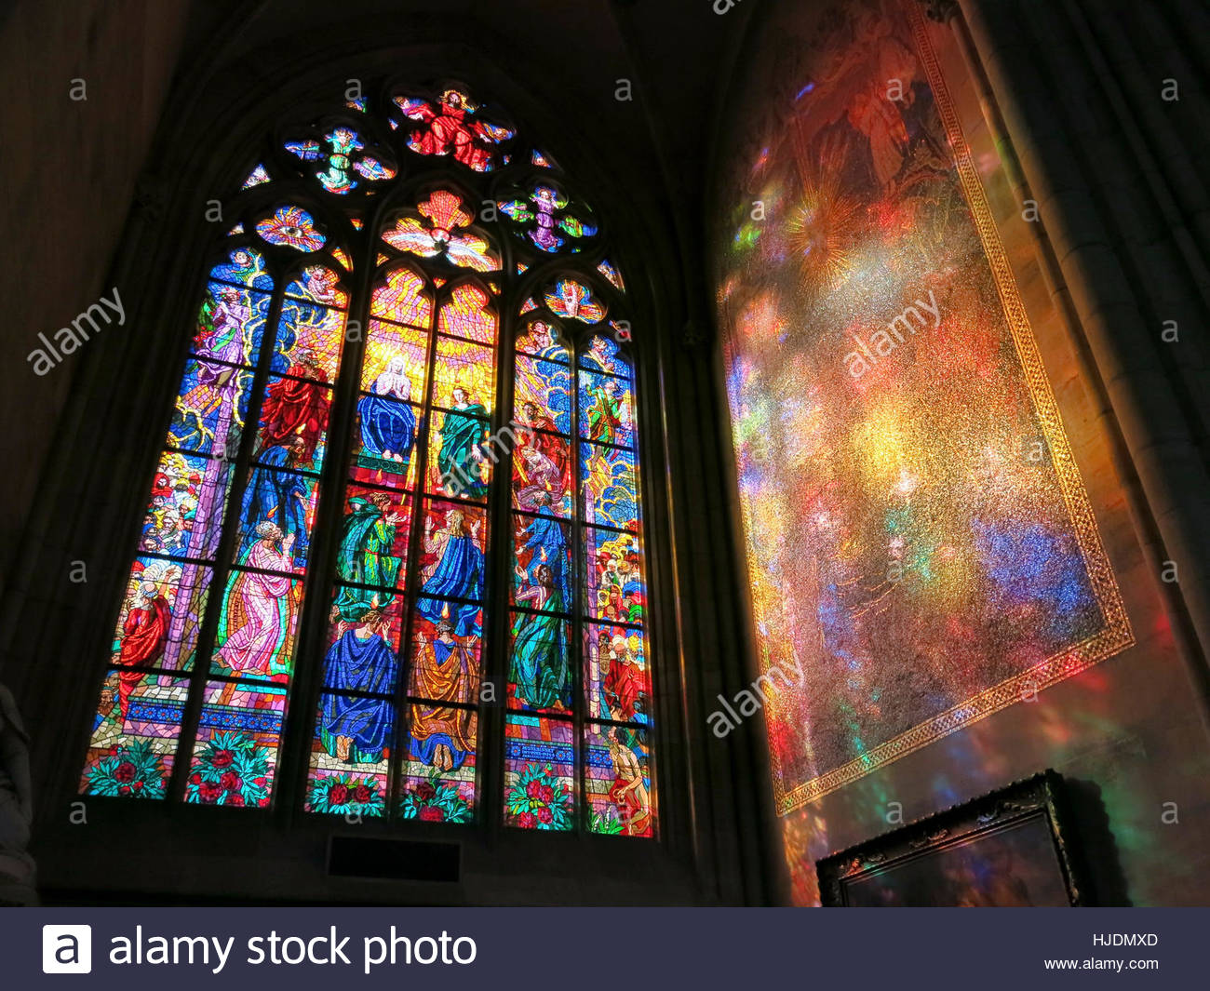
https://www.youtube.com/watch?v=xtmo_HzykaA&t=4s

Slide 6
Medieval Individual Thought
What does the Gothic cathedral provide for the individual?
Peasants
Nobles

Slide 7
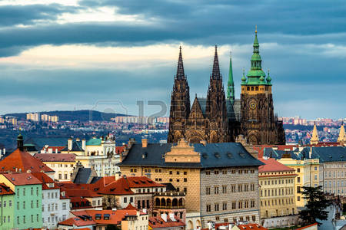
What would be the impression of the townspeople? Would social class impact their perception?

Slide 8
What would the Medieval individual feel as they view Gothic Cathedrals?
Inspiration
Hope in a challenging world
View the construction process
Meeting ground

Slide 9
“The principle of the Gothic architecture is infinity made imaginable.”
Samuel Taylor Coleridge

Slide 10
Gothic Style
French origin
Created by Suger
King Louis VII on Crusade, Suger acted as regent
Define regent

Slide 11
Regent
a person appointed to administer a country because the monarch is a minor or is absent or incapacitated

Slide 12
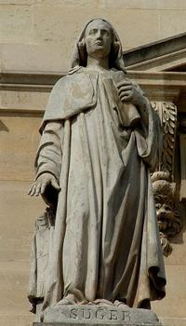
Suger

Slide 13
Suger as Regent
“Father of the fatherland” – Willelmus
Explain the meaning of this quote
Goals: To strengthen the French monarchy
Abbot of St. Denis in 1122
Will transform St. Denis into a Gothic structure

Slide 14
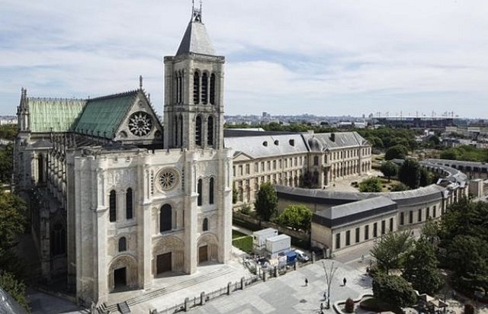
St. Denis in France

Slide 15
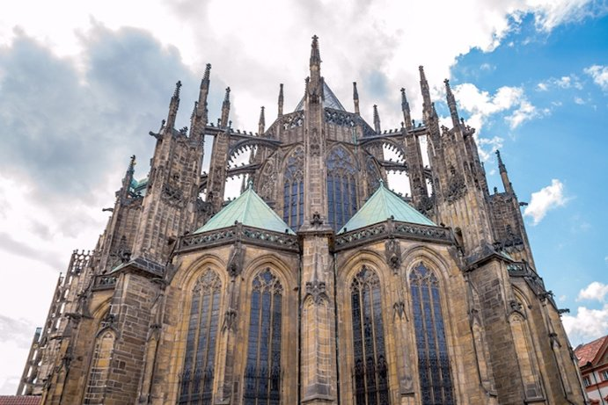
Romanesque and Gothic Architecture Compare
What are the differences?
What inspired the change?

Slide 16
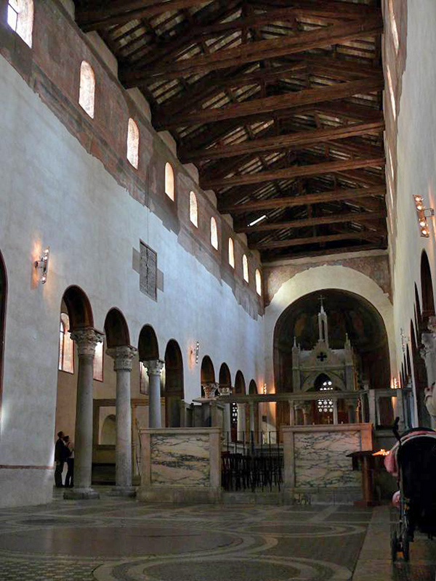
Romanesque and Gothic Interior Compare
What are the differences?
What inspired the change?

Slide 17
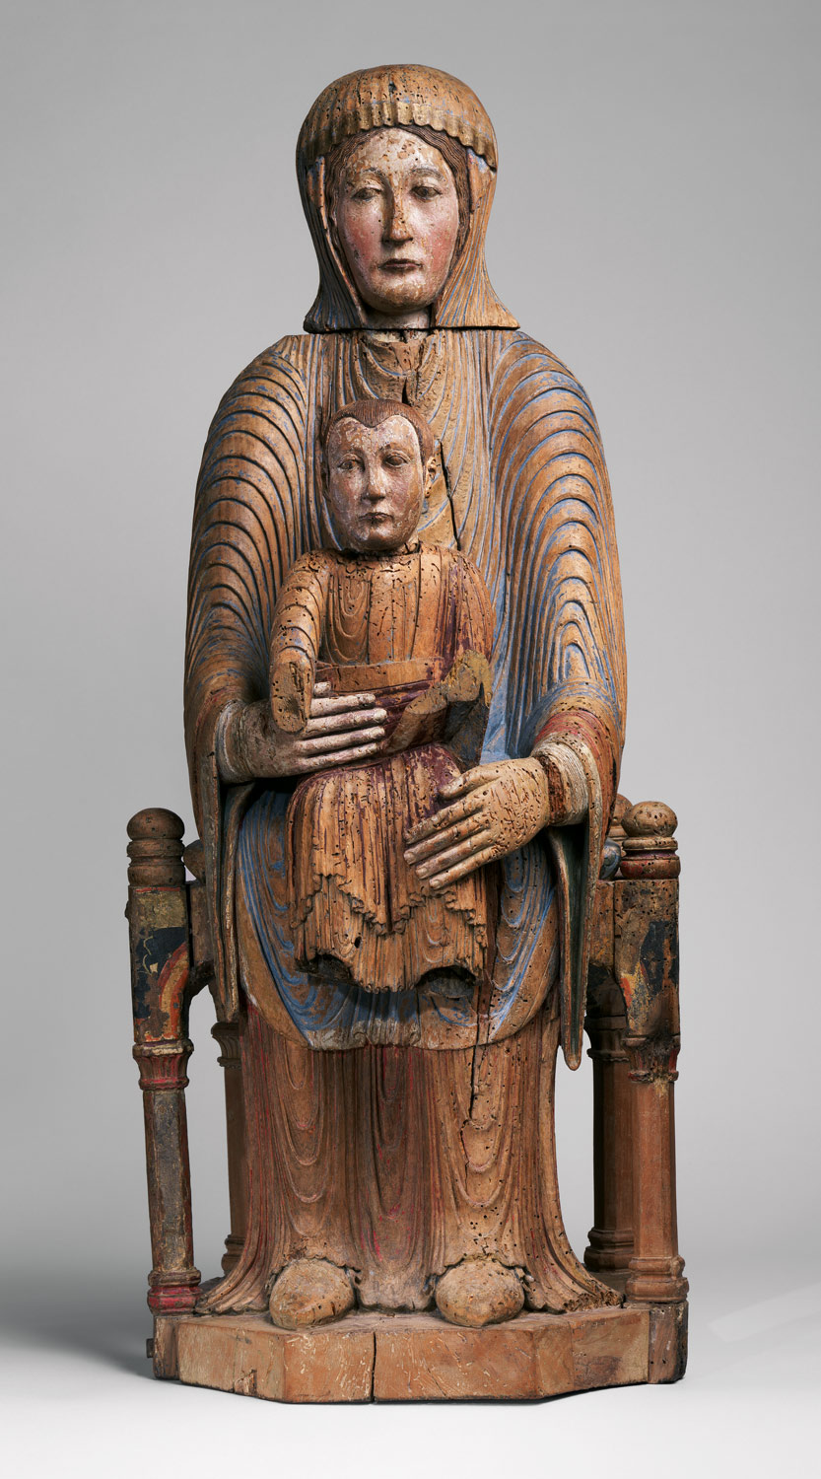
Romanesque and Gothic Sculpture Compare
What are the differences?
What inspired the change?

Slide 18
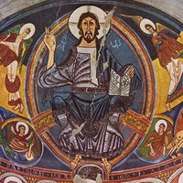
Romanesque and Gothic Art
What are the differences?
What inspired the change?

